Slide 1
MODULE - 4
Normalization

Slide 2
SYLLABUS
Different anomalies in designing a database, The idea of normalization, Functional dependency, Armstrong’s Axioms (proofs not required), Closures and their computation, Equivalence of Functional Dependencies (FD), Minimal Cover (proofs not required). First Normal Form (1NF), Second Normal Form (2NF), Third Normal Form (3NF), Boyce Codd Normal Form (BCNF), Lossless join and dependency preserving decomposition Algorithms for checking Lossless Join (LJ) and Dependency Preserving (DP) properties.

Slide 3
Different anomalies in designing a database
• Data redundancy is a condition created within a database or in which the same piece of data is held in two separate places.
• Redundancy leads to
Wastes storage
Causes problems with update anomalies
Insertion anomalies
Deletion anomalies
Updation anomalies

Slide 4
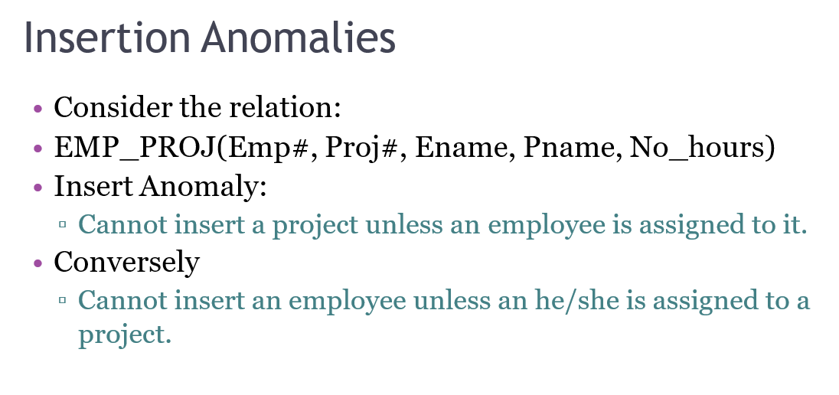

Slide 5
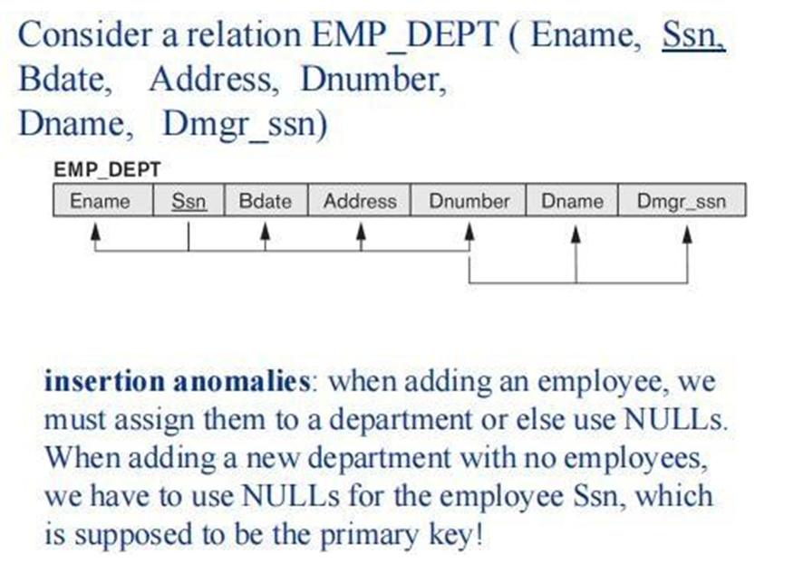

Slide 6
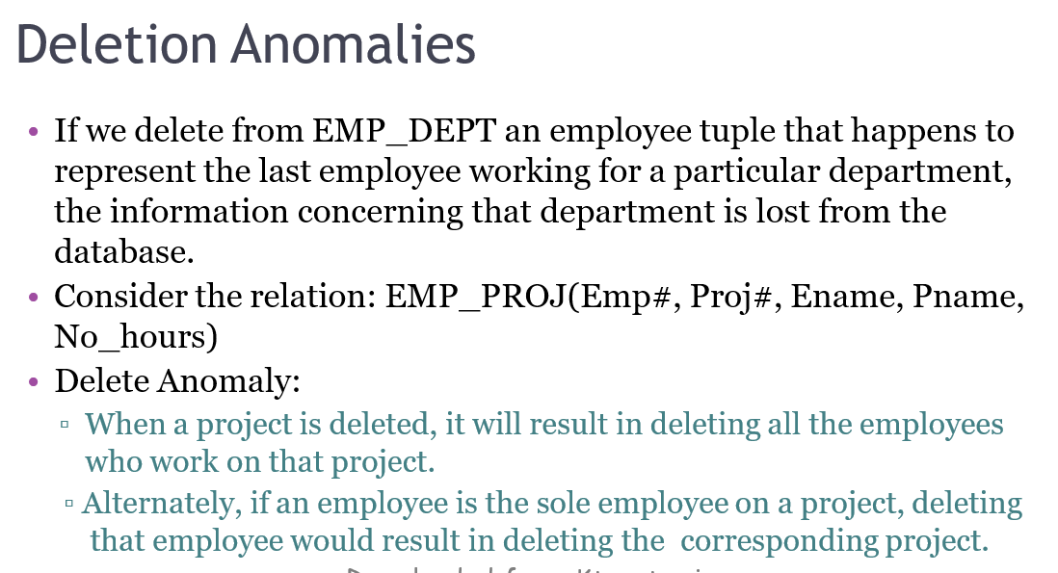

Slide 7
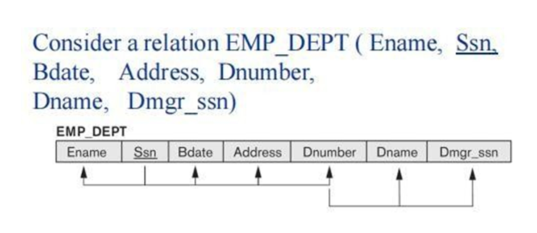
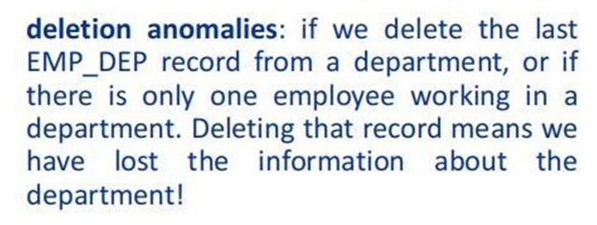

Slide 8
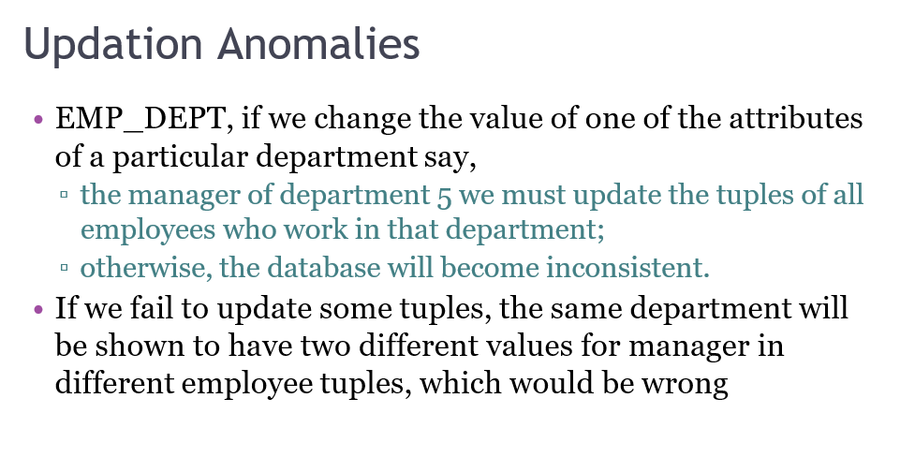

Slide 9
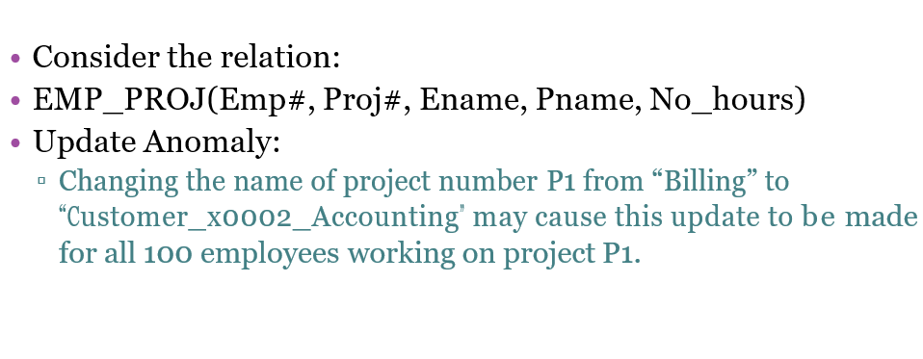

Slide 10
Normalization
The normalization process, as first proposed by Codd, takes a relation schema through a series of tests to certify whether it satisfies a certain normal form.
Normalization is the process of organizing the data in the database
It is used to minimize the redundancy from a relation or set of relations
It is also used to eliminate the insertion anomaly, update anomaly and deletion anomaly
It divides the larger table into the smaller table and links them using relationship

Slide 11
Normalization of data can be considered a process of analyzing the given relation schemas based on their FDs and primary keys to achieve the desirable properties of:
(1) minimizing redundancy and
(2) minimizing the insertion, deletion, and update anomalies.
It can be considered as a “filtering” or “purification” process to make the design have successively better quality.
Unsatisfactory relation schemas that do not meet certain conditions—the normal form tests—are decomposed into smaller relation schemas that meet the tests and hence possess the desirable properties.
The normal form of a relation refers to the highest normal form condition that it meets, and hence indicates the degree to which it has been normalized.

Slide 12
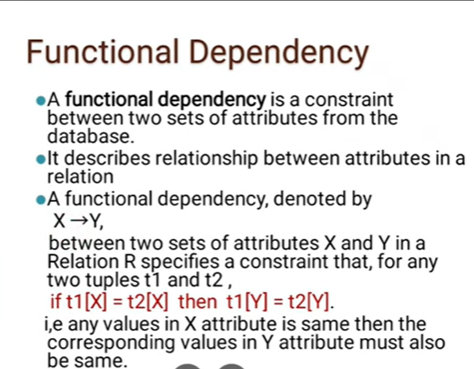

Slide 13
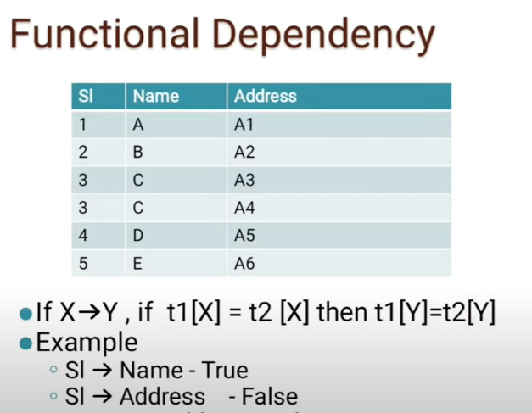

Slide 14
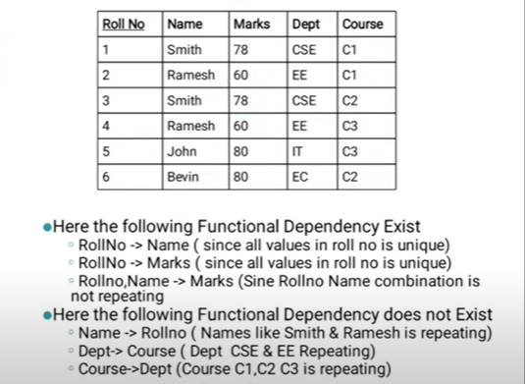

Slide 15
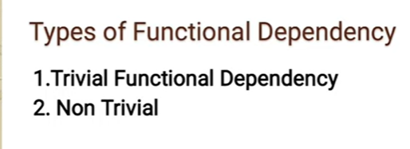

Slide 16
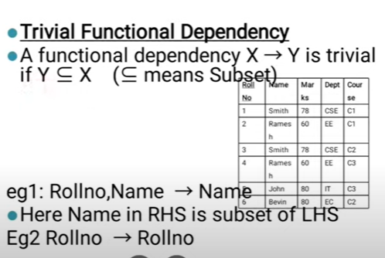

Slide 17
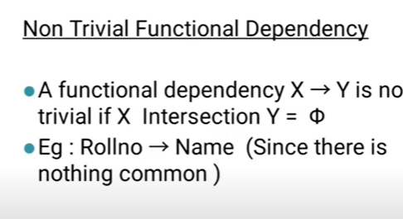

Slide 18
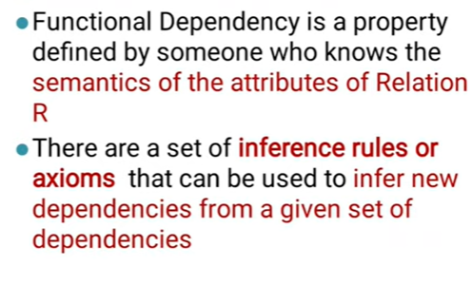
Inference Rules or Axioms

Slide 19
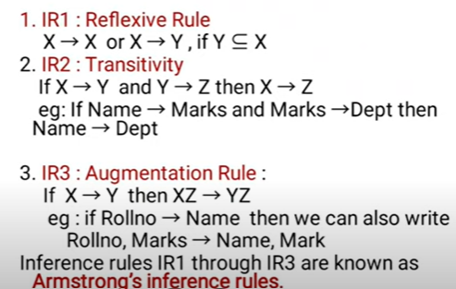
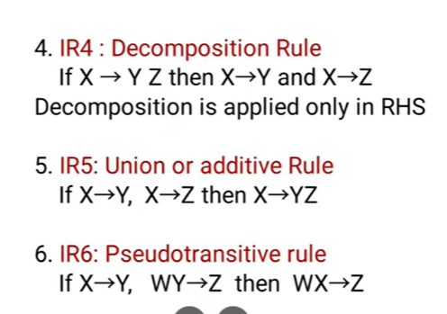
Inference Rules or Axioms

Slide 20
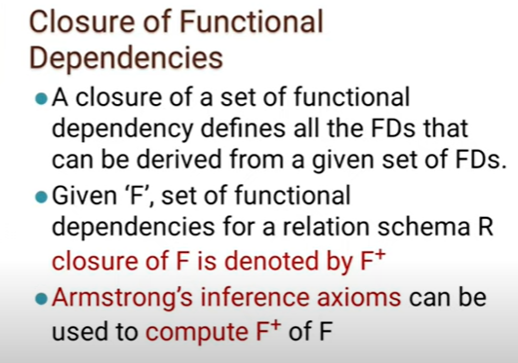

Slide 21
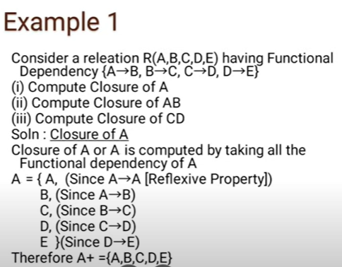
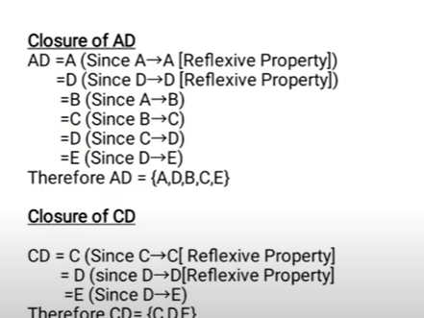

Slide 22
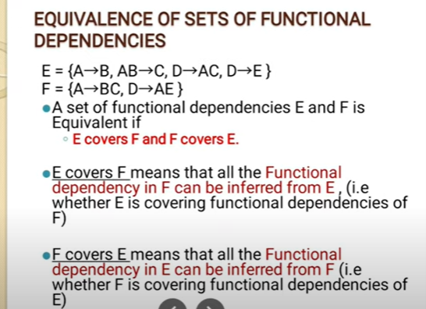

Slide 23
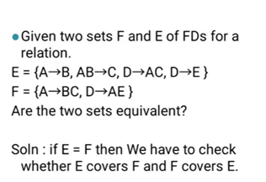
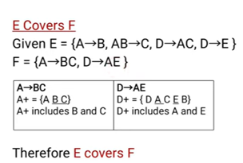
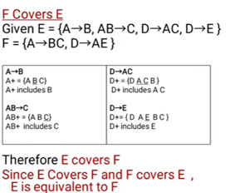

Slide 24
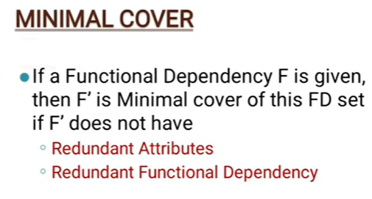
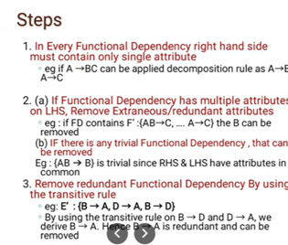

Slide 25
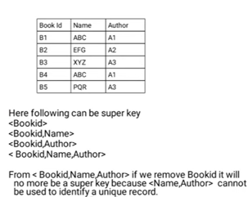
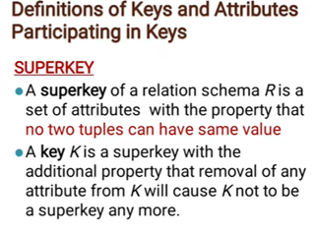

Slide 26
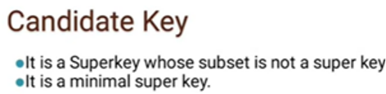
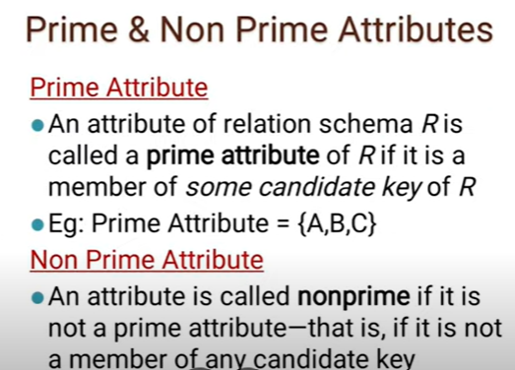


Slide 27
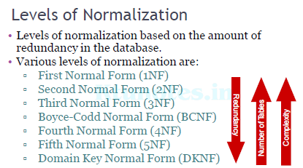
Levels of Normalization

Slide 28
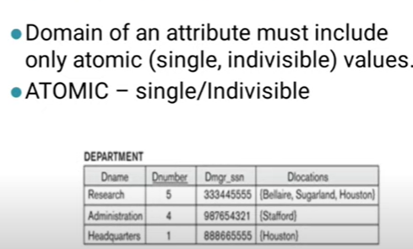
First Normal Form

Slide 29
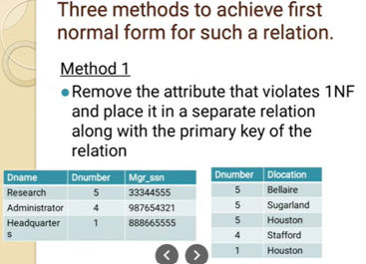
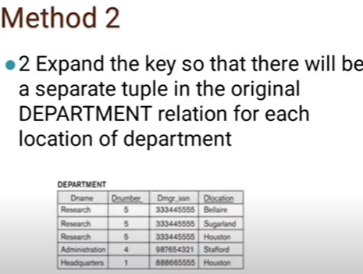

Slide 30
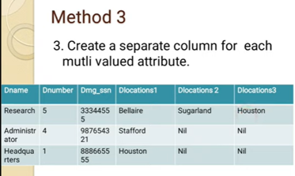

Slide 31
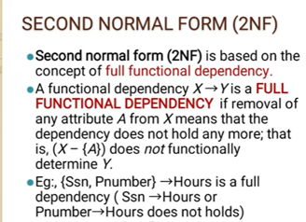
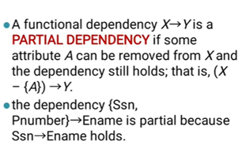

Slide 32
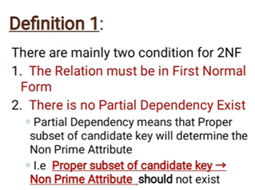

Slide 33
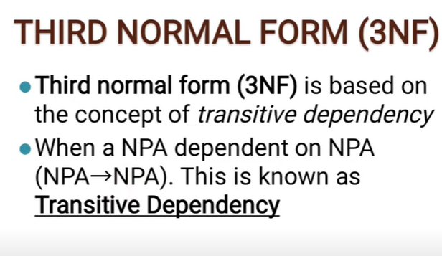

Slide 34
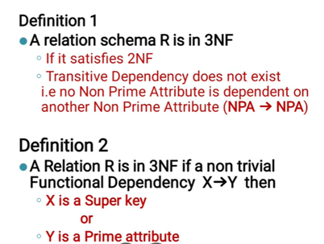

Slide 35
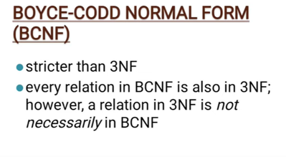
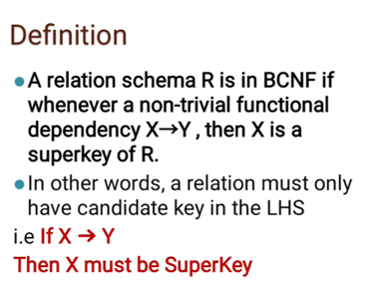

Slide 36
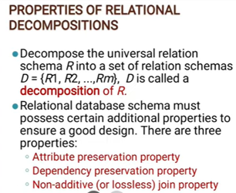

Slide 37
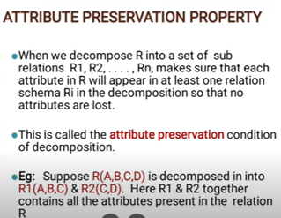
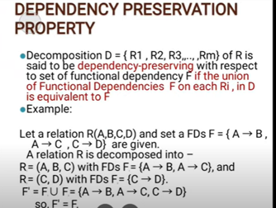

Slide 38
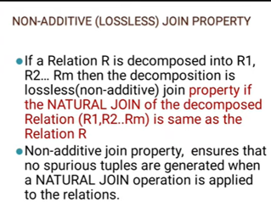
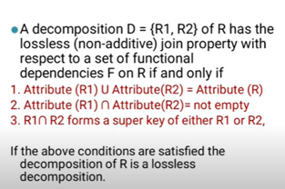

Slide 39
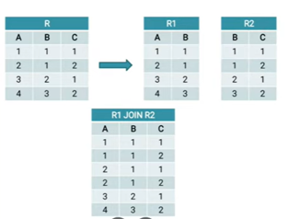
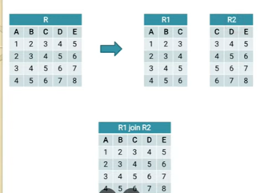
Does not ensure lossless join property
Ensures lossless join property

Slide 40
Refer notebook for problems based on module - 4

